Slide 1

Credit EDA Case Study
Submitted By :
Leena Dalvi

Slide 2
Data Exploration
Data:
There are 122 columns and 307511 rows, in the given application dataset.
Previous records of the Users who have opted for loan earlier
Problem Statement :
To find the solution to minimize the risk of company’s economic loss, while categorizing the customer, whether to approve for loan or not.

Slide 3
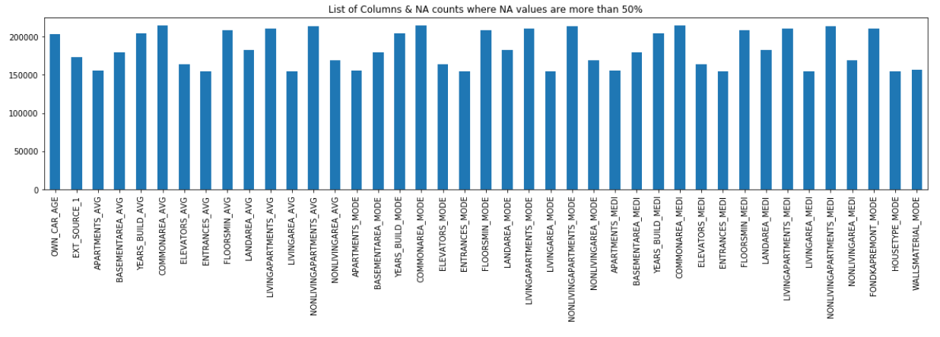
Data Cleaning and Manipulation
In this dataset, 41 columns have null values above 50% and are discarded from dataset.
Taking into consideration, the columns with 13% around or less null values, in order, to impute values, as per categorization.
FIG: Finding percentage of missing values more than 50%

Slide 4
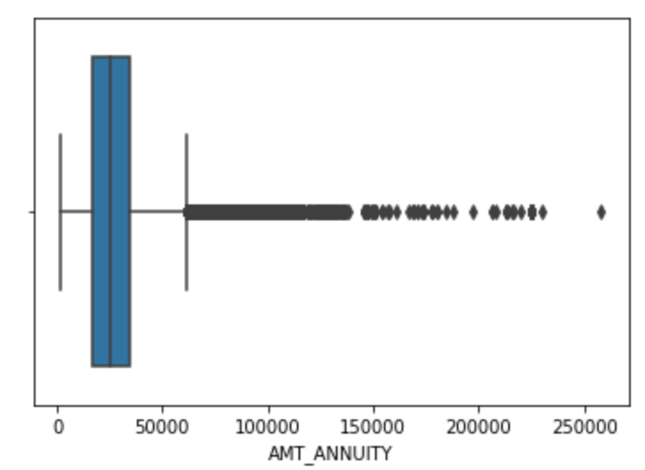
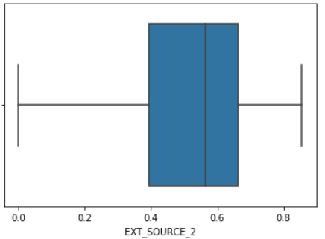
Data Handling
Handling missing values
Deleting the Rows:
The number of null values for DAYS_LAST_PHONE_CHANGE and
CNT_FAM_MEMBERS are insignificant, which s 1 and 2 respectively.Hence we can delete these 2 rows.
Replacing with Max/Mean/Mode/Median:
There are outliers in the AMT_ANNUITY column, so replacing the null value with median.(Graph shown in right)
There are no outlier in the EXT_SOURCE_2, so replacing NULL values with mean .565821. (Graph shown in right)
Replacing the missing value with 0
AMT_GOODS_PRICE, is the price of good that the client asked for in previous application and it is conditional. Missing value may present, not applicable cases. We can replace with 0 as price can not be negative.

Slide 5
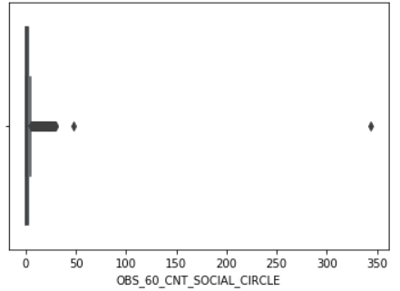
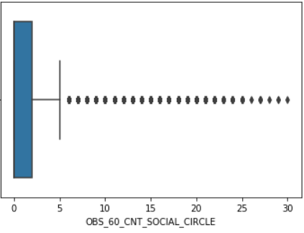
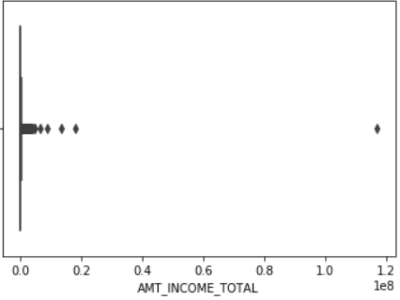
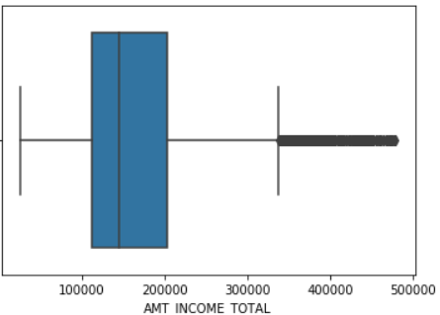
Treating outliers
Before Treatment
After Treatment

Slide 6
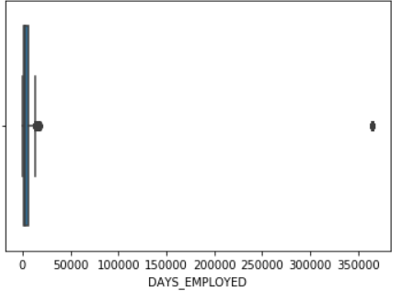
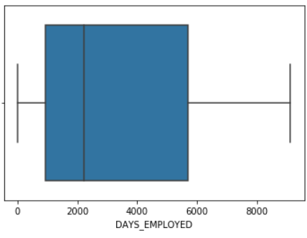
Treating outliers (Contd.)
Before Treating
After Treating

Slide 7
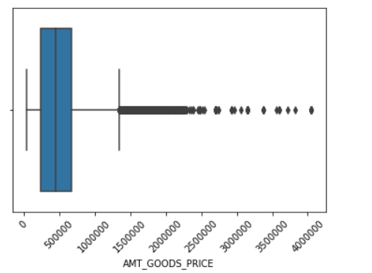
Binning of Continuous variable
From the AMT_ANNUITY column, the number of people under:
Avg Income : 179399
Low Income : 105885
High Income : 21192
Similar way it goes for AMT_GOODS_PRICE:
Average Goods : 155358
Cheap Goods : 79565
Expensive Goods : 71287
As the outliers are continuous values here, we go for Binning solution, instead of eliminating data.

Slide 8
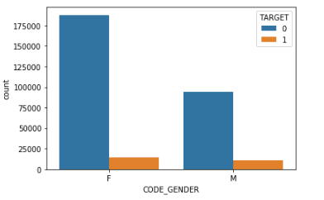
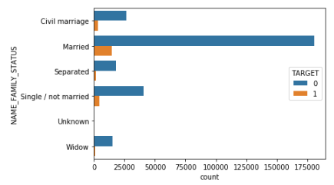
Data Analysis
CODE_GENDER (Right side bar graph):
Female ratio is more both in previous and current loan data
Difference is more in past and it is reducing in present data
NAME_FAMILY_STATUS (Left side bar graph):
Married people are more likely to take loan
Widows are less likely taking the loan

Slide 9
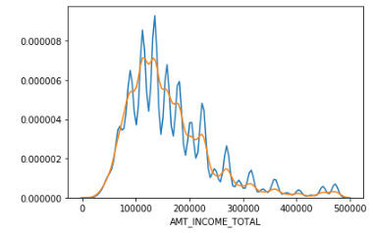
Data Analysis(Cont..)
Univariate for numerical variables
AMT_INCOME_TOTAL (Right side bar graph):
Variation is high in present loan data
Max lies between 90000 and 150000
High income are availing loan more compared to past.

Slide 10
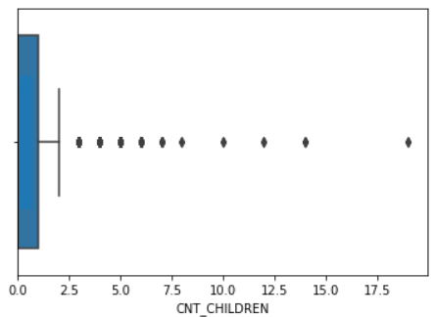
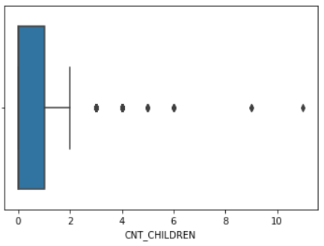
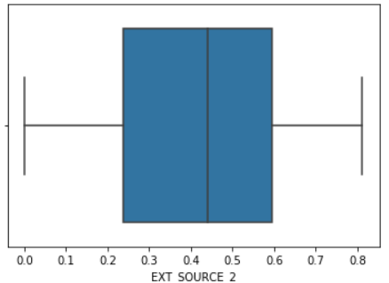
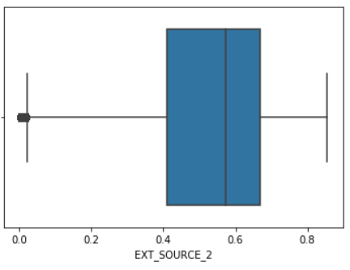
Univariate for numerical variables
Significant distant outliers in CNT_CHILDREN, but for EXT_SOURCE_2, we can find that Target1 has no outliers, but Target2 has outliers nearby whiskers.

Slide 11
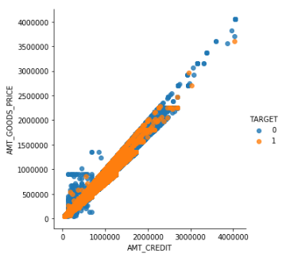
Bivariate Analysis
AMT_GOODS_PRICE vs AMT_CREDIT:
Both values are highly correlated
AMT_GOODS_PRICE increases with AMT_CREDIT
There is a cluster in new users data with low AMT_CREDIT an AMT_GOODS_PRICE
The behaviour is similar for old as well as new loan takers

Slide 12
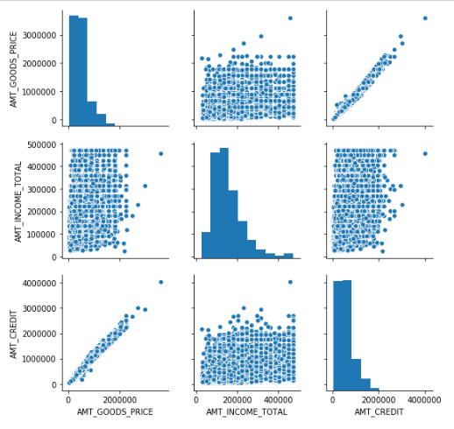
AMT_GOODS_PRICE and AMT_CREDIT are highly correlated
AMT_INCOME_TOTAL and AMT_CREDIT are randomly related
AMT_CREDIT and AMT_INCOME_TOTAL are randomly related, however there are few outliers

Slide 13
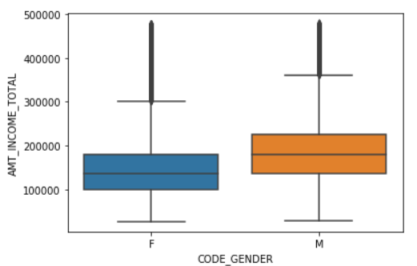
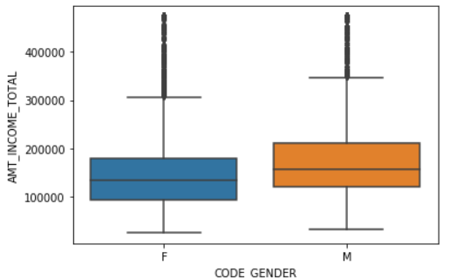
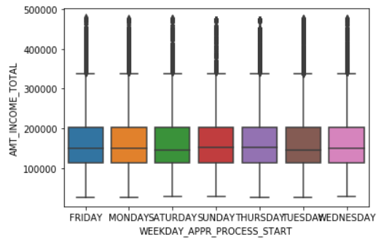
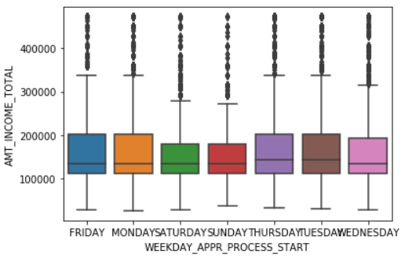
Numerical - categorical
There is vast difference in the medians for Male and Female output, for their Annual income, for both the Targets, with continuous outliers.
Also, while comparing for each day graph, there is consistency in the median for Target0, but variation seen for Target1.

Slide 14
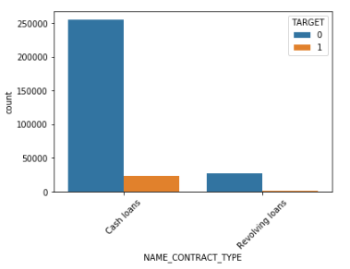
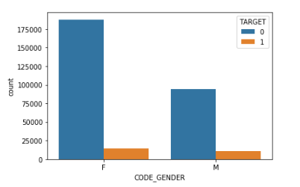
Categorical - Categorical
Cash Loans are having more demands historically
Female users are more likely to take loans than male users
Combinedly, it can be derived that the Female users are more likely to take Cash Loans

Slide 15
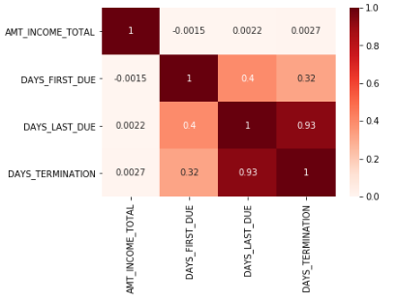
Merged Data: Previous records, Current Records
DAYS_LAST_DUE seems to have close value to one for DAYS_TERMINATION, which means there is high correlation between DAYS_LAST_DUE and DAYS_TERMINATION

Slide 16
Conclusion
The risk is higher when loan is given to Academic Degree and Widows, having no annual income. The likelihood of default is more. The loan may be Cancelled.
The Female candidates with average income, fall under Secondary/Secondary special category and opting for Cash loans are having less risk based on historical analysis. Those are bear the potential to be Approved
There is a very less percentage of users with high income have taken loan earlier. There is a increase in demand with no previous record is observed.
In such cases loan can be Refused.

Slide 17
THANK YOU

